Slide 1

REGIONAL STEERING COMMITTEE
11 SEP 2024

Slide 2









Join the movement
Implementation of awareness campaign
Achieve gold status in the EMS Angels Awards
Have enough
stroke-ready
hospitals
Get all hospitals to gold in the ESO/WSO
Angels Awards
Target achievement date:

Slide 3
Angels Mangaung
Regional Steering Committee
Steering committee coordinator
Hospital representative/s
Neurointerventional representative/s
Nurse representative/s
EMS representative/s
FAST Heroes representative/s (or Patient support organization representative)
Local government representative/s
Other members

Slide 4
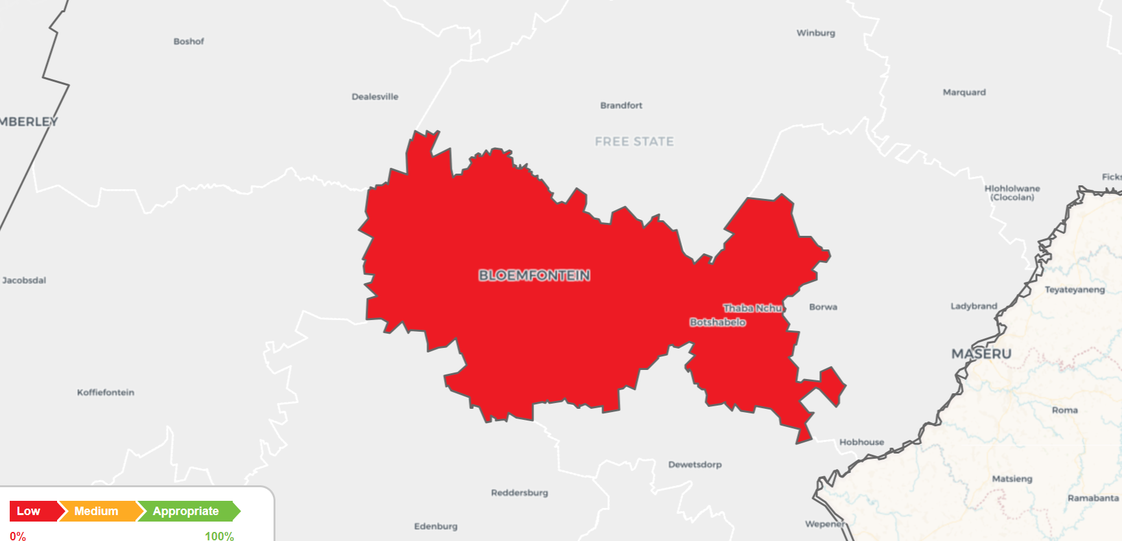
Angels Mangaung
Overall regional status map

Slide 5
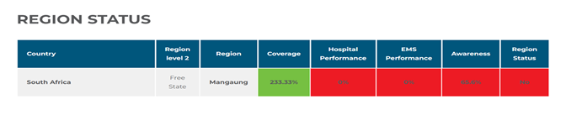
Angels Mangaung
Overall regional status

Slide 6
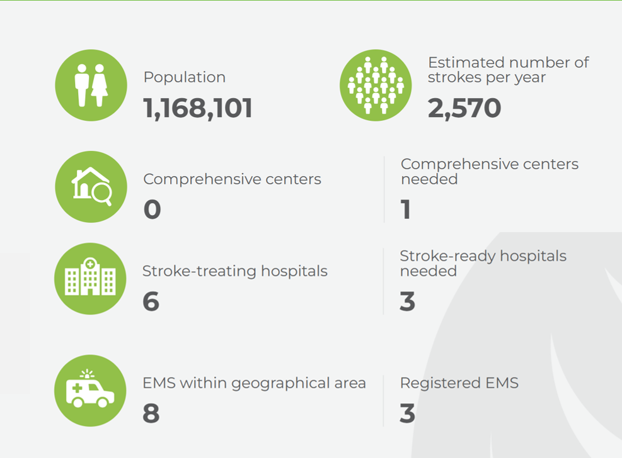
Regional coverage
Regionally agreed target
The task here is to agree on the optimal number and best distribution of hospitals in the region to provide all patients with good access to acute and post-acute care. Several points will be considered in this process. The final agreed number will be termed our Regionally Agreed Target. Keep in mind that this is an aspirational number to work towards even if this number is not achieved yet.
Regional coverage should aim to provide each stroke patient in the region with equal opportunity to access thrombolysis, thrombectomy and post-acute care as recommended by international guidelines.
Points to consider in determining the Regionally Agreed Target:
Geographical coverage. Looking at the map on the next page, it should be possible to determine if the region is appropriately covered geographically. The map shows a 45-minute driving distance around each hospital. If an area is not adequately served, the consideration should be to identify a hospital in that area that can be made part of the Stroke Network.
The Formula. The table on the left shows the number of hospitals needed based on the population and the estimated stroke incidence in this region. If a more accurate number for the incidence is available, please feel free to update the formula. The formula is based on the premise that in a good system every hospital admits around 500 stroke patients a year. Reducing the number of hospitals to a number lower than suggested by the formula is possible, but the following implications must be considered.
Driving distances. Fewer hospitals might mean longer driving distances for patients.
Monitored beds needed. Fewer hospitals means higher numbers of patients per hospital per year. This is not necessarily a problem in the acute phase, but it has an implication for the post-acute phase. The guidelines recommend that all stroke patients should be admitted to a Stroke Unit and closely monitored for at least 72 hours. A hospital that admits 500 patients would need around 6 monitored beds. For 1,000 patients they would need around 12 beds. If the hospitals in the region have or can get that number of monitored post-acute beds, then reducing the number of hospitals and therefore increasing the number of admissions per hospital per year, is not a problem. If there are more hospitals currently in the region than the formula recommends this would translate into fewer patients per hospital per year. The risk in this case is that it could make it more difficult to achieve and maintain high standards.
During the workshop, the Angels Consultant can provide you with an Excel file to simulate the impact of more or fewer hospitals in the region. You can use this to determine the Regionally Agreed Target number for this region.

Slide 7
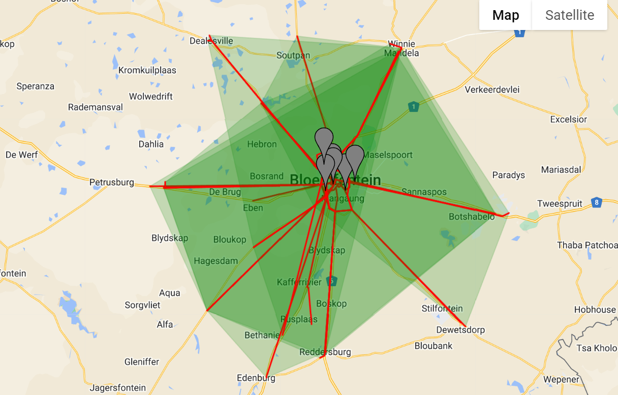
Regionally agreed target for number of hospitals
Regionally agreed target:

Slide 8

Hospital performance
All hospitals that form part of the regional Stroke Network should achieve at least Gold status in the ESO/WSO Angels Awards program.
This is an indication that they are achieving the minimum standard of stroke care for their patients.
Considerations
Quality monitoring. Evidence has shown that consistent quality monitoring has a bigger effect on reducing stroke mortality than mechanical thrombectomy alone. Therefore, guidelines recommend that all hospitals should have quality monitoring systems in place.
Insights Months. Angels supports the RES-Q and SITS Registries’ twice-yearly data collection activations. Angels Insights Months are March and September, when hospitals are encouraged to capture all stroke patients admitted over the course of that month.
In-hospital consultancy. To assist hospitals in targeting areas for improvement.
Data for each hospital, EMS company and FAST Heroes implementation should be presented at follow-up regional meetings.

Slide 9
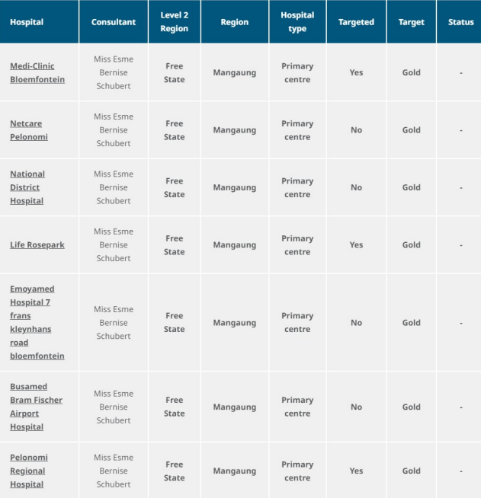
Hospital performance

Slide 10
EMS performance
All EMS companies that manage stroke patients in this region should achieve at least Gold status in the EMS Angels Awards program. This is an indication that they are achieving the minimum standard of stroke care for their patients.
Awards criteria include:
Median time on scene
% Prenotification to hospital
% of patients delivered to stroke-ready hospitals
% of patients where medication details are reported
% of patients with time last known normal is reported
Considerations:
Quality monitoring. Evidence has shown that consistent quality monitoring has a bigger effect on reducing stroke mortality than mechanical thrombectomy alone. Therefore, guidelines recommend that all hospitals should have quality monitoring systems in place. The same would hold true for EMS companies.
Insights Months. Angels supports the RES-Q and SITS Registries’ twice-yearly data collection activations. Angels Insights Months are March and September, when hospitals are encouraged to capture all stroke patients admitted over the course of the month.
Protocols for management of stroke patients.
Protocols for choosing the most appropriate hospital to deliver the patient to.
Communication between hospitals and EMS.
Protocols for secondary transfer.
Consultancy and training of EMS.

Slide 11
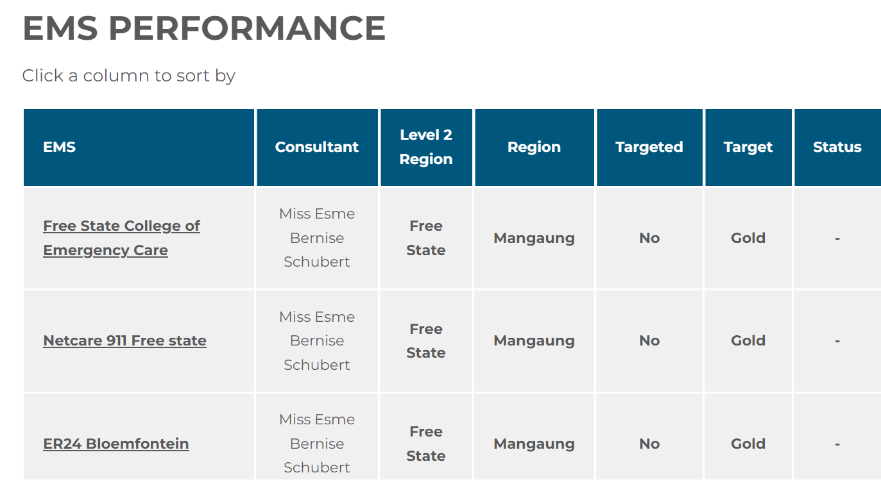
EMS performance

Slide 12
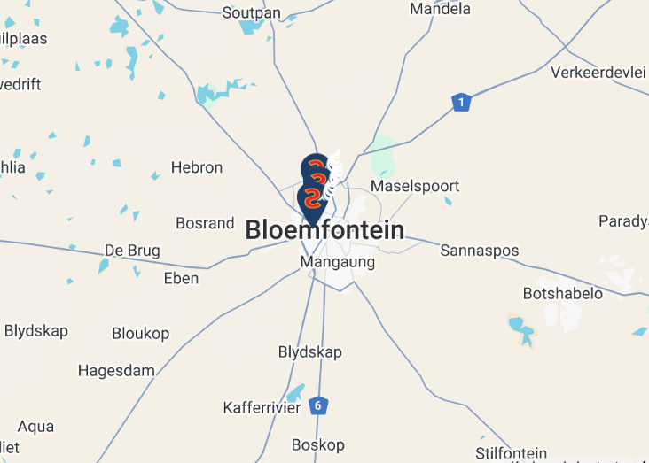
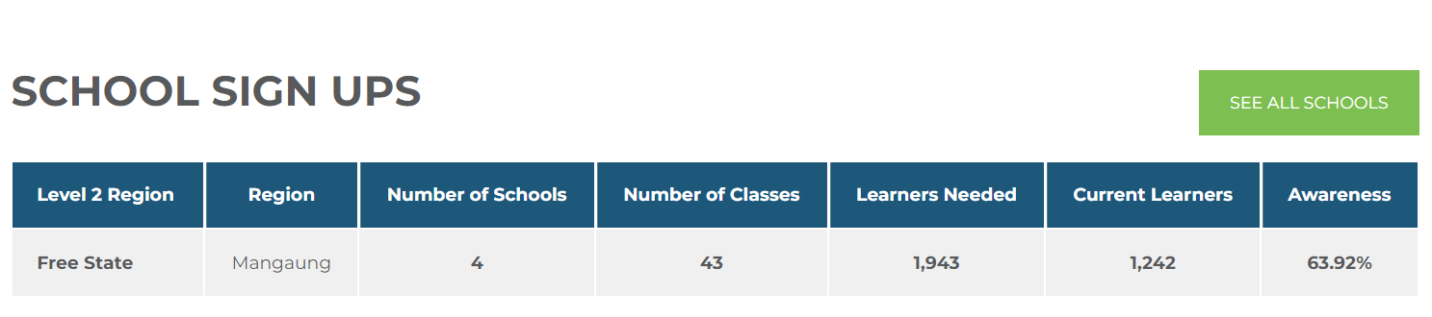
Awareness performance
Our aim in the pre-hospital phase is for stroke patients to only be admitted to stroke-ready hospitals and for patients to arrive as fast as possible after onset of their symptoms.
Experience has shown that to achieve this we need more patients to arrive by ambulance. Arriving by ambulance reduces the risk of patients being incorrectly triaged, resulting in time wasted waiting in the ED waiting room. A recent survey showed that 53% of stroke patients who did not come to hospital by ambulance chose a hospital that was nearest to them and not one that was stroke ready.
If EMS companies are trained on which hospitals are stroke ready, the likelihood of patients being admitted to the most appropriate hospital instead of the closest hospital increases.
To achieve this, we need to improve population awareness on the following topics:
Recognition that their symptoms are stroke symptoms. (As low as 23% Malaysia, 23% Italy, 44% Poland*)
Need to call an ambulance (Ambulance use as low as 31% Malaysia, 58% Italy, 80% Poland*)
Emergency number to call (Only 32% Malaysia knew the correct number, 79% Poland*)
We need to educate not only the stroke patients but also their close friends and relatives. (69% called a relative first, only 11% gave the correct advice. In Poland 68% gave the correct advice*)
Discussion points:
Introduction of the FAST Heroes Coordinator.
Process of FAST Implementation.
Formula for determining the target number of kids to be trained.
How to involve more schools.
Involving the local authorities such as the Mayor or local municipality to assist in school recruitment.
How hospital and EMS staff can assist with enrolling more schools.
How hospitals and EMS staff can get involved in the implementation of FAST Heroes.
*Polish results are after implementation of FAST Heroes

Slide 13
Current FAST Heroes activities & achievements

Slide 14
Angels Mangaung
Regional action plan
Area for improvement | Action | Due date | Involved

Slide 15
Regional action plan
Area for improvement | Action | Due date | Involved

Slide 16


